Slide 1
A perspective from Industry
Robert Day
Head of Oncology, Pfizer UK

Slide 2
What we’ll cover during this presentation
The contribution of the pharmaceutical industry to medical advances
How the medicines market works
How the industry is changing
Cancer Medicines and it’s impact on NHS budgets
Access issues

Slide 3
Innovation has transformed patients’ lives in many disease areas
Schizophrenia
Infectious disease
Breast Cancer
Ulcers
Asthma
HIV/Aids
Leukaemia
High cholesterol/CHD

Slide 4
Selected Advances in the 20th Century
1900s – 1940s
1950s – 1970s
1980s – 2000
1950s
1950 – Discovery of prednisone
1951 – First Rx for depression
1953 – First leukemia Rx
1954 – Polio vaccine
1958 – First diuretic to treat high blood pressure
1980s
1981 – First ACE inhibitor to treat high blood pressure
1986 – First monoclonal antibody
treatment
1987 – New class of depression
medicines (SSRIs)
– First AIDS Rx
– First statins to lower
cholesterol
1900–1929
1908 – Tuberculosis vaccine
1922 – Insulin for diabetes
1924 – Tetanus vaccine
1928 – Discovery of penicillin
1930s & 1940s
1932 – First antibiotic (sulfa drugs)
1935 – Discovery of cortisone
1938 – First epilepsy Rx
1948 – First chemotherapy Rxs
1960s & 1970s
1963 – Measles vaccine
1967 – First beta blocker
1968 – First anti-rejection medicines
for organ transplants
1972 – Advances in anesthesia
1977 – First non-surgical treatment
for ulcers
1978 – First biotech product
(synthetic human insulin)
1990s
1993 – First Alzheimer’s Rx
1994 – New breast cancer Rx
- Polio eradicated in the
Americas
1995 – AIDS Rx advance (HAART)
1995–97 – Four new classes
of oral diabetes Rxs
1997–98 – Advance in
Parkinson’s Therapies
Sources: Innovation.org, Great Moments in Innovation, http://www.innovation.org/index.cfm/nonav/Great_Moments_in_Innovation; NIH, National Institute of Allergy and Infectious Disease, Tuberculosis (TB), Age of Optimism, http://www3.niaid.nih.gov/topics/tuberculosis/Research/researchFeatures/history/historical_optimism.htm.

Slide 5
Selected Advances Since 2000
2000–2008
2002
• New classes of blood pressure and cholesterol Rxs
• New mAb Rx for rheumatoid arthritis
• New class for attention deficit/hyperactivity
disorder
2006
• First medicine approved for chronic
chest pain in 20 years
• First vaccine for the prevention
of cervical cancer
• New option for a rare leukemia
• First once-a-day HIV medicine
2000
• First mAb-targeted chemotherapy
• New class for macular
degeneration
• First HIV medicine approved for children as young as 6 months
2004
• New Rx for most common form of lung cancer
• New mAb treatment for colorectal cancer
• New class of treatment for depression
First mAb treatment for multiple sclerosis
• First anti-angiogenic medicine for cancer
2001
• First molecular targeted
cancer Rx for leukemia
• First major advance in the
treatment of blood
poisoning in 20 years
• Advance in treatment of
hepatitis C
2003
First Rx for severe Alzheimer’s
• Human genome mapped
• New class of HIV treatment –
fusion inhibitors
• First biotechnology treatment for asthma
2005
• First new kidney cancer Rx in over a decade
• Advance in insomnia therapy
• Three new therapies for diabetes
2007
• New class to treat high blood pressure
• First treatment for fibromyalgia
• Two new first-in-class HIV drugs
* mAb = monoclonal antibody
Source: Innovation.org, Great Moments in Innovation, http://www.innovation.org/index.cfm/nonav/Great_Moments_in_Innovation; FDA website, at www.fda.gov.

Slide 6
Generating a positive trade balance
The pharmaceutical sector continues to generate an ever-widening trade surplus¹ and now makes a greater contribution to the UK economy than any other sector of industry in the UK

Slide 7
Innovation in healthcare is costly and time-consuming

Slide 8
Drug development is long, costly and unpredictable

Slide 9
Attrition rates for Cancer are higher than any other disease area
This has been particularly evident in phase III failures in recent years.

Slide 10
New Medicines R&D: Cash Flow, intellectual property & patents
From a global perspective. The industry has significant “sunk costs” which can only be recouped after launch – importance of uptake
Patent Expires
File
Patent
Sales
income
5
10
R & D
costs
Development
Phase
15
20
25
30
Research
Phase
Years
Shearson/Lehman Report
(For illustrative purposes)

Slide 11
Even After Approval, only 2 in 10 make their money back
Lifetime Sales Compared to Average R&D Costs
New Rx Drugs Introduced Between 1990 and 1994, Grouped by Tenths, by Lifetime Sales
Note: Drug development costs represent after-tax out-of-pocket costs in 2000 dollars for drugs introduced from 1990–94. The same analysis found that the total cost of developing a new drug was $1.3 billion in 2006. Average R&D Costs include the cost of the approved medicines as well as those that fail to reach approval.
Sources: J. A. Vernon, J. H. Golec, and J.A. DiMasi, "Drug development costs when financial risk is measured using the Fama-French three-factor model." Health Economics, (2009). ; J. DiMasi and H. Grabowski, “The Cost of Biopharmaceutical R&D: Is Biotech Different?,” Managerial and Decision Economics, 2007.

Slide 12
An example of a success story

Slide 13
The cardiovascular story
Diuretics (1958)
Beta blockers (1970)
ACE inhibitors (1981)
Statins (1987)
New agents for diabetes (1995)
40-50% of the reduction in mortality due to innovative cardiovascular treatments¹
The vast majority of these medicines will be off-patent by the end of 2012
http://www.nice.org.uk/niceMedia/documents/CHD_Briefing_nov_04.pdf

Slide 15
The cardiovascular story
These medicines have been successful around 25,000 lives per year have been saved
Access was granted and uptake has paid for their development and has funded future development of new medicines in different therapy areas
The costs to the NHS have been significant, but future costs will be much lower post LoE
This was a successful model,
.....but nothing stays the same forever

Slide 16
The industry is changing

Slide 17
Shift from branded to generic prescribing

Slide 18
Research and development is focusing on smaller patient populations
Focus of research in the 90’s
Large population diseases
Cholesterol, high blood pressure, urology, respiratory
Focus of research in the 00’s
High unmet need specialist areas
Cancers (rare and more common), auto-immune disease,
Brilliantly a much greater focus on Cancer medicines, but hypercholesterolaemia effects, arguably, 50% of western populations, melanoma deaths amount to 48,000 worldwide.

Slide 19
The costs of these medicines appear high on an individual patient basis
Costs of new innovative cancer medicines can often be around £20-30k per year or higher.
Budget impacts can be significantly smaller compared to “blockbusters” of the 90’s.

Slide 20
Factors considered in UK price setting
Pricing
Decision
Alternative
Treatment
Prices
DH approval
For Non-NAS
PPRS
Profit cap
Corporate
Return on R&D
Investment
Patient
Population
Primary Market
Research
Likely VFM
assessment
European
pricing
corridor

Slide 21
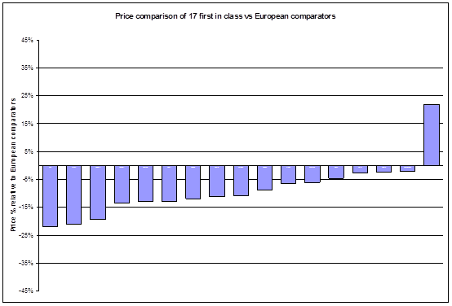
UK launch prices for first in class 9% below European average
Price comparison of first in class medicines. UK price relative to European comparators
2004-2007
Source ABPI OFT PPRS review submission

Slide 22
UK prices are among the lowest for high income countries
 | 2000 DH est | 2000 Rank | 2006 DH est | 2006 Rank | 2008 DH est | 2008 Rank | 2009 ABPI est | 2009 rank
USA | 209 | 1 | 188 | 1 | 252 | 1 | 272 | 1
Germany | 91 | 3 | 105 | 2 | 142 | 2 | 149 | 2
Ireland | 83 | 4 | 105 | 2 | 134 | 3 | 140 | 3
Belgium | 78 | 9 | 97 | 6 | 122 | 4 | 125 | 4
Finland | 83 | 4 | 96 | 7 | 119 | 5 | 115 | 8
Netherlands | 81 | 6 | 94 | 8 | 115 | 6 | 122 | 6
Austria | 77 | 10 | 94 | 8 | 111 | 7 | 119 | 7
France | 80 | 7 | 89 | 10 | 108 | 8 | 117 | 8
Sweden | NA |  | 103 | 4 | 116 | 9 | 123 | 5
Spain | 64 | 11 | 85 | 11 | 109 | 10 | 113 | 10
Italy | 79 | 8 | 78 | 12 | 101 | 11 | 109 | 11
UK | 100 | 2 | 100 | 5 | 100 | 12 | 100 | 12
Nevertheless the cost of cancer medicine continues to be a source of public debate

Slide 23
Will this break the NHS budget?

Slide 24
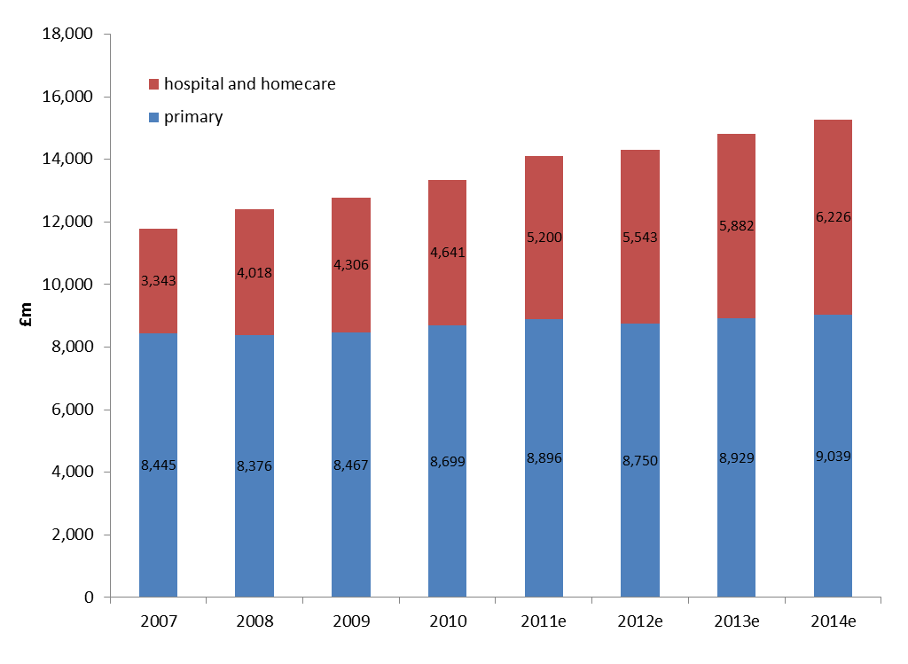
Estimate of growth in medicines bill to 2014

Slide 25
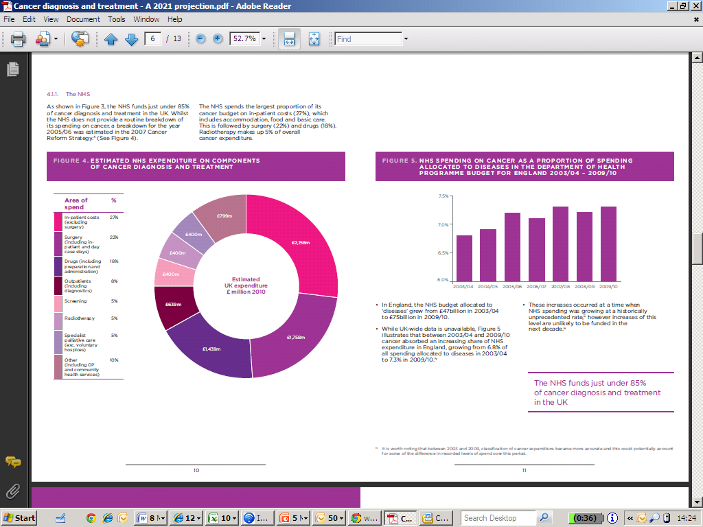
The cost of Cancer treatment relative to other diseases

Slide 26
Total NHS and primary care medicines expenditure, England, 2003 - 2009

Slide 27
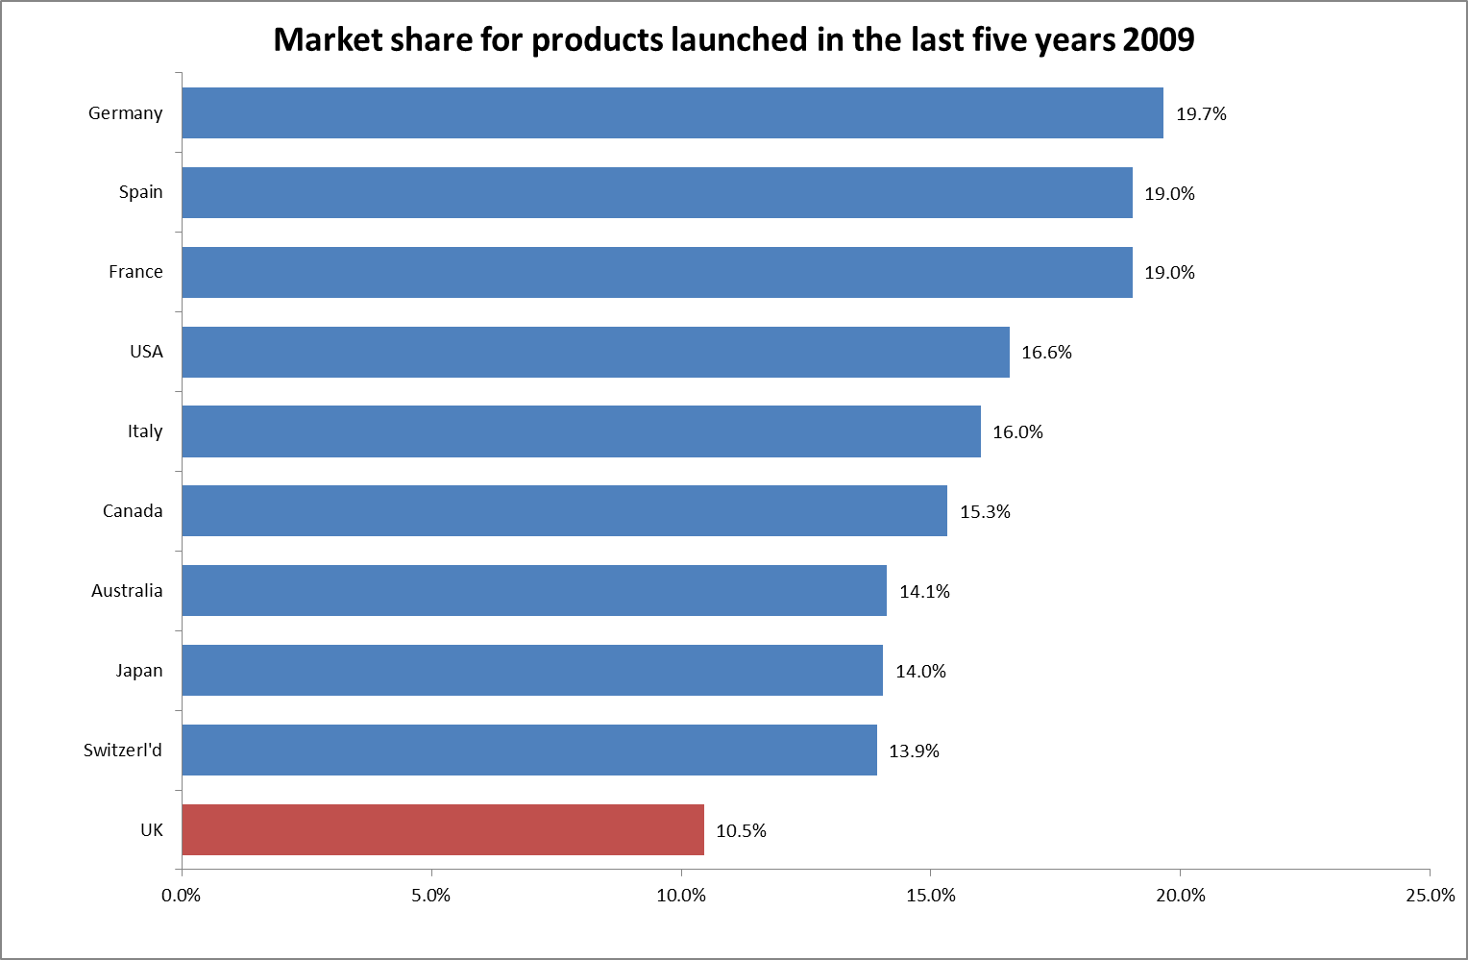
Uptake of new medicines is slow in the UK
% of medicines bill

Slide 28
Access
22 assessments in the last 18 months for Cancer drugs
11 – Yes/Maybe
11 – No
Cancer Drug Fund has picked up a significant number of patients requiring non-NICE approved drugs, it is unclear what will happen post 2014
Or whether this will be enough to meet the original ambition.

Slide 29
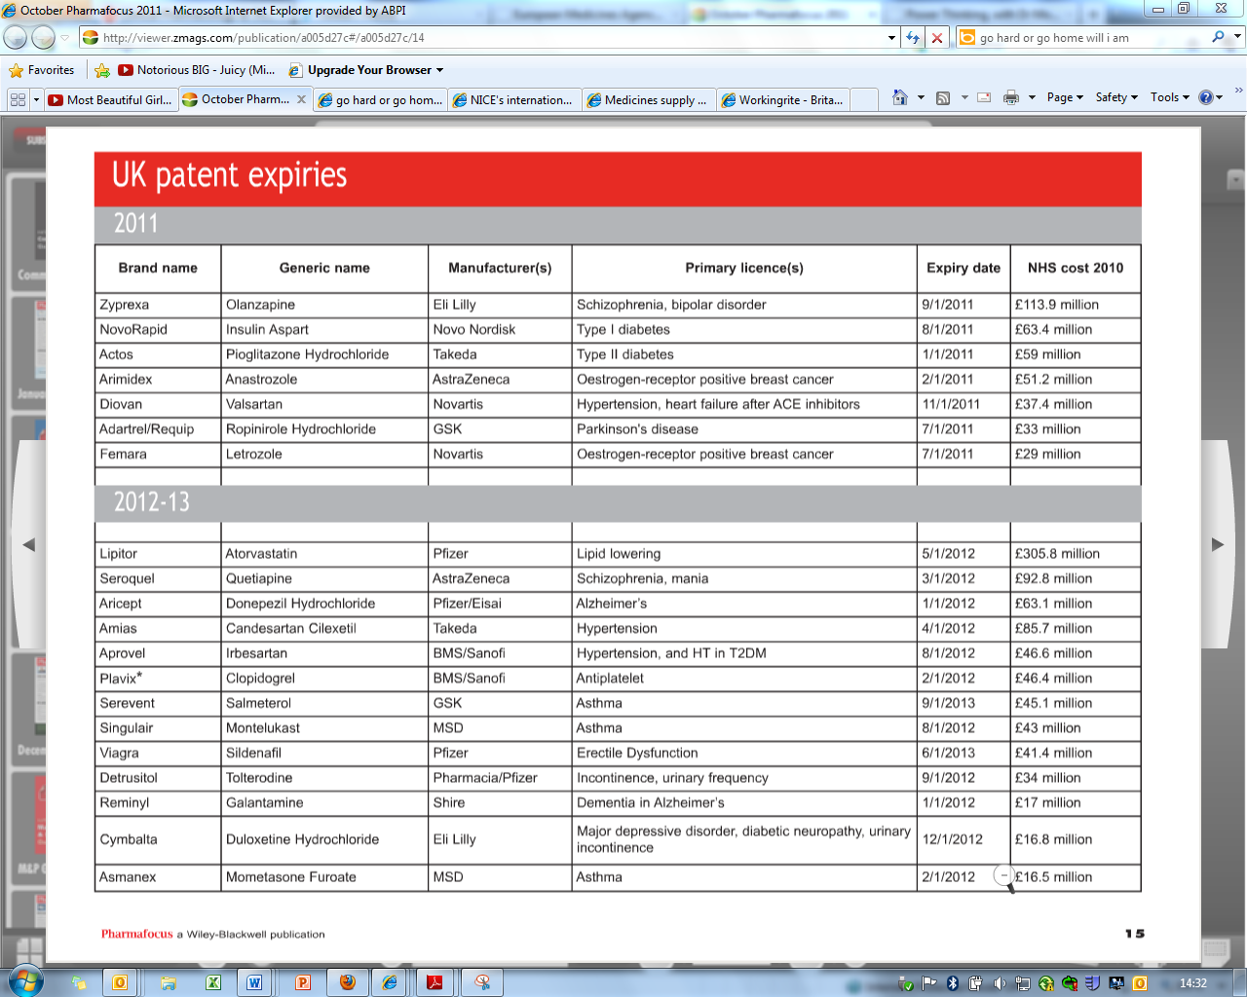
Key patent expiries in 2011/12
See full article from DailyFinance: http://srph.it/eNsmU9
Total patent expiry opportunity for savings in the region of £1.2MM in 2011 and 2012

Slide 30
Medicines life cycle in UK... delivering efficiencies but out of balance.
UK prices are amongst the lowest in Europe
UK has very efficient use of generics
UK has slow & low use of innovative medicines
3 price cuts since 2005
83% generic prescribing
66% dispensed as generics
Average price of generics amongst lowest in Europe
Cancer therapies: Even after 5
years only achieved 2/3rds
average usage in appropriate
patients
Maximise value for patient, NHS & Industry
Encourage Innovation
Efficiency
0.9 % GDP is spent on medicines compared to EU average 1.2%
Source: Compendium of Health Statistics 2009 (OHE), updated Hospital prescribing data (IC) PPA and PCA data. Market Statistics IMS World Review, OECD GDP data. PPRS reports to Parliament 6th and 10th IMS world review EGA National Association 2007. EU 15 countries.

Slide 31
Summary
The development of medicines is an expensive and risky business
UK has the lowest prices in Europe
UK has a healthy generics market, there as a result of previous drug discovery efforts
The industry has invested heavily in rarer diseases with high unmet need
However there is low uptake and poor access still in the UK
NHS will benefit from pending patent cliff to the tune of £3.6bn between now and 2014
In the UK we need to address uptake of innovative medicines to ensure there is incentive for further investment in Cancer research

